Slide 1
Goal Mometer
Add a subgoal
Goal: Write Thesis

Slide 2
Goal Mometer
A star means it’s an important goal. Click here if this is one.
Goal: Write Thesis
Sub Goal: Lit. Review
If not, click to add a subgoal to this goal.

Slide 3
Goal Mometer
Want to add all tasks first? Click to add another.
Goal: Write Thesis
Sub Goal: Lit. Review
Task: Read Paper 1
Want to complete tasks as you add them? Click on the task to say it is finished.

Slide 4
Goal Mometer
Goal: Write Thesis
Sub Goal: Lit. Review
Task: Read Paper 1
Task: Read Paper 2

Slide 5
Goal Mometer
Goal: Write Thesis
Sub Goal: Lit. Review
Task: Read Paper 1
Task: Read Paper 2
Sub Goal: Make Outline

Slide 6
Goal Mometer
Goal: Write Thesis
Sub Goal: Lit. Review
Task: Read Paper 1
Task: Read Paper 2
Sub Goal: Make Outline
Sub Goal: Write Thesis

Slide 7
Goal Mometer
Goal: Write Thesis
Sub Goal: Lit. Review
Task: Read Paper 1
Task: Read Paper 2
Sub Goal: Make Outline
Sub Goal: Write Thesis
Task: Intro

Slide 8
Goal Mometer
Goal: Write Thesis
Sub Goal: Lit. Review
Task: Read Paper 1
Task: Read Paper 2
Sub Goal: Make Outline
Sub Goal: Write Thesis
Task: Intro
Sub Task: Write Abstract

Slide 9
Goal Mometer
Goal: Write Thesis
Sub Goal: Lit. Review
Task: Read Paper 1
Task: Read Paper 2
Sub Goal: Make Outline
Sub Goal: Write Thesis
Task: Intro
Sub Task: Write Abstract
Task: Content

Slide 10
Goal Mometer
Goal: Write Thesis
Sub Goal: Lit. Review
Task: Read Paper 1
Task: Read Paper 2
Sub Goal: Make Outline
Sub Goal: Write Thesis
Task: Intro
Sub Task: Write Abstract
Task: Content
Sub Task: Write ¶ 1

Slide 11
Goal Mometer
Goal: Write Thesis
Sub Goal: Lit. Review
Task: Read Paper 1
Task: Read Paper 2
Sub Goal: Make Outline
Sub Goal: Write Thesis
Task: Intro
Sub Task: Write Abstract
Task: Content
Sub Task: Write ¶ 1
Sub Task: Write ¶ 2

Slide 12
Goal Mometer
Goal: Write Thesis
Sub Goal: Lit. Review
Click on the goal to complete it.
Task: Read Paper 1
Task: Read Paper 2
Sub Goal: Make Outline
Sub Goal: Write Thesis
Task: Intro
Sub Task: Write Abstract
Task: Content
Sub Task: Write ¶ 1
Sub Task: Write ¶ 2
Task: Conclusion

Slide 13
Goal Mometer
Goal: Write Thesis
Sub Goal: Lit. Review
Task: Read Paper 1
Task: Read Paper 2
Sub Goal: Make Outline
Sub Goal: Write Thesis
Task: Intro
Task: Content
Sub Task: Write ¶ 1
Sub Task: Write ¶ 2
Task: Conclusion

Slide 14
Goal Mometer
Goal: Write Thesis
Sub Goal: Lit. Review
Task: Read Paper 1
Task: Read Paper 2
Sub Goal: Make Outline
Sub Goal: Write Thesis
Task: Intro
Sub Task: Write Abstract
Task: Content
Task: Conclusion

Slide 15
Goal Mometer
Goal: Write Thesis
Sub Goal: Lit. Review
Sub Goal: Lit. Review
Task: Read Paper 1
Task: Read Paper 2
Sub Goal: Make Outline
Sub Goal: Write Thesis
Task: Intro
Task: Content
Task: Conclusion

Slide 16
Goal Mometer
Goal: Write Thesis
Sub Goal: Lit. Review

Slide 17
Goal Mometer
Goal: Write Thesis
Sub Goal: Lit. Review
Sub Goal: Make Outline

Slide 18
Goal Mometer
Goal: Write Thesis
Sub Goal: Lit. Review
Sub Goal: Make Outline
Sub Goal: Write Thesis

Slide 19
Goal Mometer
Goal: Write Thesis
Sub Goal: Lit. Review
Sub Goal: Make Outline
Sub Goal: Write Thesis
Task: Intro

Slide 20
Goal Mometer
Goal: Write Thesis
Sub Goal: Lit. Review
Sub Goal: Make Outline
Sub Goal: Write Thesis
Task: Intro
Sub Task: Write Abstract

Slide 21
Goal Mometer
Goal: Write Thesis
Sub Goal: Lit. Review
Sub Goal: Make Outline
Sub Goal: Write Thesis
Task: Intro
Sub Task: Write Abstract
Task: Content

Slide 22
Goal Mometer
Goal: Write Thesis
Sub Goal: Lit. Review
Sub Goal: Make Outline
Sub Goal: Write Thesis
Task: Intro
Sub Task: Write Abstract
Task: Content
Sub Task: Write ¶ 1

Slide 23
Goal Mometer
Goal: Write Thesis
Sub Goal: Lit. Review
Sub Goal: Make Outline
Sub Goal: Write Thesis
Task: Intro
Sub Task: Write Abstract
Task: Content
Sub Task: Write ¶ 1
Sub Task: Write ¶ 2

Slide 24
Goal Mometer
Goal: Write Thesis
Sub Goal: Lit. Review
Sub Goal: Make Outline
Sub Goal: Write Thesis
Task: Intro
Sub Task: Write Abstract
Task: Content
Sub Task: Write ¶ 1
Sub Task: Write ¶ 2
Task: Conclusion

Slide 25
Goal Mometer
Goal: Write Thesis
Sub Goal: Lit. Review
Sub Goal: Make Outline
Sub Goal: Write Thesis
Task: Intro
Task: Content
Sub Task: Write ¶ 1
Sub Task: Write ¶ 2
Task: Conclusion

Slide 26
Goal Mometer
Goal: Write Thesis
Sub Goal: Lit. Review
Sub Goal: Make Outline
Sub Goal: Write Thesis
Task: Intro
Sub Task: Write Abstract
Task: Content
Task: Conclusion

Slide 27
Goal Mometer
Goal: Write Thesis
Sub Goal: Lit. Review
Sub Goal: Make Outline
Sub Goal: Write Thesis
Task: Intro
Task: Content
Task: Conclusion

Slide 28
Goal Mometer
Goal: Write Thesis
Sub Goal: Lit. Review
Task: Read Paper 1
Task: Read Paper 2
Sub Goal: Make Outline
Sub Goal: Write Thesis

Slide 29
Goal Mometer
Goal: Write Thesis
Sub Goal: Lit. Review
Sub Goal: Make Outline
Sub Goal: Write Thesis

Slide 30
Goal Mometer
Cick to add a subgoal to this goal.
Goal: Write Thesis
Sub Goal: Lit. Review

Slide 31
Goal Mometer
Want to add all tasks first? Click to add another.
Goal: Write Thesis
Sub Goal: Lit. Review
Task: Read Paper 1
Want to complete tasks as you add them? Click on the task to say it is finished.

Slide 32
Goal Mometer
Goal: Write Thesis
Sub Goal: Lit. Review
Task: Read Paper 1
Task: Read Paper 2

Slide 33
Goal Mometer
Goal: Write Thesis
Sub Goal: Lit. Review
Task: Read Paper 1
Task: Read Paper 2
Sub Goal: Make Outline

Slide 34
Goal Mometer
Goal: Write Thesis
Sub Goal: Lit. Review
Task: Read Paper 1
Task: Read Paper 2
Sub Goal: Make Outline
Sub Goal: Write Thesis

Slide 35
Goal Mometer
Goal: Write Thesis
Sub Goal: Lit. Review
Task: Read Paper 1
Task: Read Paper 2
Sub Goal: Make Outline
Sub Goal: Write Thesis
Task: Intro

Slide 36
Goal Mometer
Goal: Write Thesis
Sub Goal: Lit. Review
Task: Read Paper 1
Task: Read Paper 2
Sub Goal: Make Outline
Sub Goal: Write Thesis
Task: Intro
Sub Task: Write Abstract

Slide 37
Goal Mometer
Goal: Write Thesis
Sub Goal: Lit. Review
Task: Read Paper 1
Task: Read Paper 2
Sub Goal: Make Outline
Sub Goal: Write Thesis
Task: Intro
Sub Task: Write Abstract
Task: Content

Slide 38
Goal Mometer
Goal: Write Thesis
Sub Goal: Lit. Review
Task: Read Paper 1
Task: Read Paper 2
Sub Goal: Make Outline
Sub Goal: Write Thesis
Task: Intro
Sub Task: Write Abstract
Task: Content
Sub Task: Write ¶ 1

Slide 39
Goal Mometer
Goal: Write Thesis
Sub Goal: Lit. Review
Task: Read Paper 1
Task: Read Paper 2
Sub Goal: Make Outline
Sub Goal: Write Thesis
Task: Intro
Sub Task: Write Abstract
Task: Content
Sub Task: Write ¶ 1
Sub Task: Write ¶ 2

Slide 40
Goal Mometer
Goal: Write Thesis
Sub Goal: Lit. Review
Click on the goal to complete it.
Task: Read Paper 1
Task: Read Paper 2
Sub Goal: Make Outline
Sub Goal: Write Thesis
Task: Intro
Sub Task: Write Abstract
Task: Content
Sub Task: Write ¶ 1
Sub Task: Write ¶ 2
Task: Conclusion

Slide 41
Goal Mometer
Goal: Write Thesis
Sub Goal: Lit. Review
Task: Read Paper 1
Task: Read Paper 2
Sub Goal: Make Outline
Sub Goal: Write Thesis
Task: Intro
Task: Content
Sub Task: Write ¶ 1
Sub Task: Write ¶ 2
Task: Conclusion

Slide 42
Goal Mometer
Goal: Write Thesis
Sub Goal: Lit. Review
Task: Read Paper 1
Task: Read Paper 2
Sub Goal: Make Outline
Sub Goal: Write Thesis
Task: Intro
Sub Task: Write Abstract
Task: Content
Task: Conclusion

Slide 43
Goal Mometer
Goal: Write Thesis
Sub Goal: Lit. Review
Sub Goal: Lit. Review
Task: Read Paper 1
Task: Read Paper 2
Sub Goal: Make Outline
Sub Goal: Write Thesis
Task: Intro
Task: Content
Task: Conclusion

Slide 44
Goal Mometer
Goal: Write Thesis
Sub Goal: Lit. Review

Slide 45
Goal Mometer
Goal: Write Thesis
Sub Goal: Lit. Review
Sub Goal: Make Outline

Slide 46
Goal Mometer
Goal: Write Thesis
Sub Goal: Lit. Review
Sub Goal: Make Outline
Sub Goal: Write Thesis

Slide 47
Goal Mometer
Goal: Write Thesis
Sub Goal: Lit. Review
Sub Goal: Make Outline
Sub Goal: Write Thesis
Task: Intro

Slide 48
Goal Mometer
Goal: Write Thesis
Sub Goal: Lit. Review
Sub Goal: Make Outline
Sub Goal: Write Thesis
Task: Intro
Sub Task: Write Abstract

Slide 49
Goal Mometer
Goal: Write Thesis
Sub Goal: Lit. Review
Sub Goal: Make Outline
Sub Goal: Write Thesis
Task: Intro
Sub Task: Write Abstract
Task: Content

Slide 50
Goal Mometer
Goal: Write Thesis
Sub Goal: Lit. Review
Sub Goal: Make Outline
Sub Goal: Write Thesis
Task: Intro
Sub Task: Write Abstract
Task: Content
Sub Task: Write ¶ 1

Slide 51
Goal Mometer
Goal: Write Thesis
Sub Goal: Lit. Review
Sub Goal: Make Outline
Sub Goal: Write Thesis
Task: Intro
Sub Task: Write Abstract
Task: Content
Sub Task: Write ¶ 1
Sub Task: Write ¶ 2

Slide 52
Goal Mometer
Goal: Write Thesis
Sub Goal: Lit. Review
Sub Goal: Make Outline
Sub Goal: Write Thesis
Task: Intro
Sub Task: Write Abstract
Task: Content
Sub Task: Write ¶ 1
Sub Task: Write ¶ 2
Task: Conclusion

Slide 53
Goal Mometer
Goal: Write Thesis
Sub Goal: Lit. Review
Sub Goal: Make Outline
Sub Goal: Write Thesis
Task: Intro
Task: Content
Sub Task: Write ¶ 1
Sub Task: Write ¶ 2
Task: Conclusion

Slide 54
Goal Mometer
Goal: Write Thesis
Sub Goal: Lit. Review
Sub Goal: Make Outline
Sub Goal: Write Thesis
Task: Intro
Sub Task: Write Abstract
Task: Content
Task: Conclusion

Slide 55
Goal Mometer
Goal: Write Thesis
Sub Goal: Lit. Review
Sub Goal: Make Outline
Sub Goal: Write Thesis
Task: Intro
Task: Content
Task: Conclusion

Slide 56
Goal Mometer
Goal: Write Thesis
Sub Goal: Lit. Review
Task: Read Paper 1
Task: Read Paper 2
Sub Goal: Make Outline
Sub Goal: Write Thesis

Slide 57
Goal Mometer
Goal: Write Thesis
Sub Goal: Lit. Review
Sub Goal: Make Outline
Sub Goal: Write Thesis

Slide 58


Goal Mometer
Goal: Write Thesis
Sub Goal: Lit. Review
Task: Read Paper 1
Task: Read Paper 2
Sub Goal: Make Outline
Sub Goal: Write Thesis
Task: Intro
Sub Task: Write Abstract
Task: Content
Sub Task: Write ¶ 1
Sub Task: Write ¶ 2
Task: Conclusion

Slide 59
Goal Mometer
Goal: Write Thesis
Sub Goal: Lit. Review
Task: Read Paper 1
Task: Read Paper 2
Sub Goal: Make Outline
Sub Goal: Write Thesis
Task: Intro
Sub Task: Write Abstract
Task: Content
Sub Task: Write ¶ 1
Sub Task: Write ¶ 2
Task: Conclusion

Slide 60
Goal Mometer
Goal: Write Thesis
Sub Goal: Lit. Review
Task: Read Paper 1
Task: Read Paper 2
Sub Goal: Make Outline
Sub Goal: Write Thesis
Task: Intro
Sub Task: Write Abstract
Task: Content
Sub Task: Write ¶ 1
Sub Task: Write ¶ 2
Task: Conclusion

Slide 61
Goal Mometer
Goal: Write Thesis
Sub Goal: Lit. Review
Task: Read Paper 1
Task: Read Paper 2
Sub Goal: Make Outline
Sub Goal: Write Thesis
Task: Intro
Sub Task: Write Abstract
Task: Content
Sub Task: Write ¶ 1
Sub Task: Write ¶ 2
Task: Conclusion

Slide 62
Goal Mometer
Goal: Write Thesis
Sub Goal: Lit. Review
Sub Goal: Make Outline
Sub Goal: Write Thesis
Task: Intro
Sub Task: Write Abstract
Task: Content
Sub Task: Write ¶ 1
Sub Task: Write ¶ 2
Task: Conclusion

Slide 63
Goal Mometer
Goal: Write Thesis
Sub Goal: Lit. Review
Sub Goal: Make Outline
Sub Goal: Write Thesis
Task: Intro
Sub Task: Write Abstract
Task: Content
Sub Task: Write ¶ 1
Sub Task: Write ¶ 2
Task: Conclusion

Slide 64
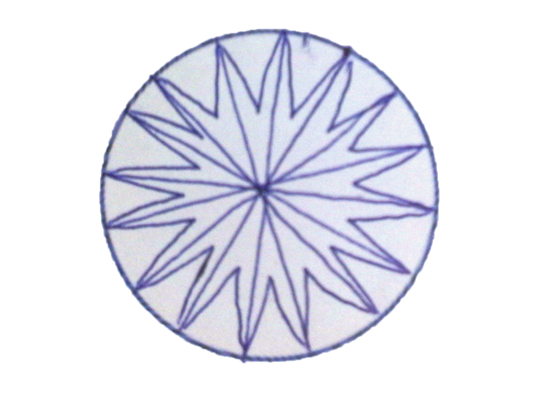
Goal Mometer
Goal: Write Thesis
Sub Goal: Lit. Review
Task: Read Paper 1
Task: Read Paper 2
Sub Goal: Make Outline
Sub Goal: Write Thesis
Task: Intro
Sub Task: Write Abstract
Task: Content
Sub Task: Write ¶ 1
Sub Task: Write ¶ 2
Task: Conclusion

Slide 65
Goal Mometer
Goal: Write Thesis
Sub Goal: Lit. Review
Task: Read Paper 1
Task: Read Paper 2
Sub Goal: Make Outline
Sub Goal: Write Thesis
Task: Intro
Sub Task: Write Abstract
Task: Content
Sub Task: Write ¶ 1
Sub Task: Write ¶ 2
Task: Conclusion

Slide 66
Goal Mometer
Goal: Write Thesis
Sub Goal: Lit. Review
Sub Goal: Make Outline
Sub Goal: Write Thesis
Task: Intro
Sub Task: Write Abstract
Task: Content
Sub Task: Write ¶ 1
Sub Task: Write ¶ 2
Task: Conclusion

Slide 67
Goal Mometer
Goal: Write Thesis
Sub Goal: Lit. Review
Sub Goal: Make Outline
Sub Goal: Write Thesis
Task: Intro
Sub Task: Write Abstract
Task: Content
Sub Task: Write ¶ 1
Sub Task: Write ¶ 2
Task: Conclusion

Slide 68

Goal Mometer
Goal: Write Thesis
Sub Goal: Lit. Review
Task: Read Paper 1
Task: Read Paper 2
Sub Goal: Make Outline
Sub Goal: Write Thesis
Task: Intro
Sub Task: Write Abstract
Task: Content
Sub Task: Write ¶ 1
Sub Task: Write ¶ 2
Task: Conclusion

Slide 69
Goal Mometer
Goal: Write Thesis
Sub Goal: Lit. Review
Task: Read Paper 1
Task: Read Paper 2
Sub Goal: Make Outline
Sub Goal: Write Thesis
Task: Intro
Sub Task: Write Abstract
Task: Content
Sub Task: Write ¶ 1
Sub Task: Write ¶ 2
Task: Conclusion

Slide 70
Goal Mometer
Goal: Write Thesis
Sub Goal: Lit. Review
Sub Goal: Make Outline
Sub Goal: Write Thesis
Task: Intro
Sub Task: Write Abstract
Task: Content
Sub Task: Write ¶ 1
Sub Task: Write ¶ 2
Task: Conclusion

Slide 71
Goal Mometer
Goal: Write Thesis
Sub Goal: Lit. Review
Sub Goal: Make Outline
Sub Goal: Write Thesis
Task: Intro
Sub Task: Write Abstract
Task: Content
Sub Task: Write ¶ 1
Sub Task: Write ¶ 2
Task: Conclusion

Slide 72
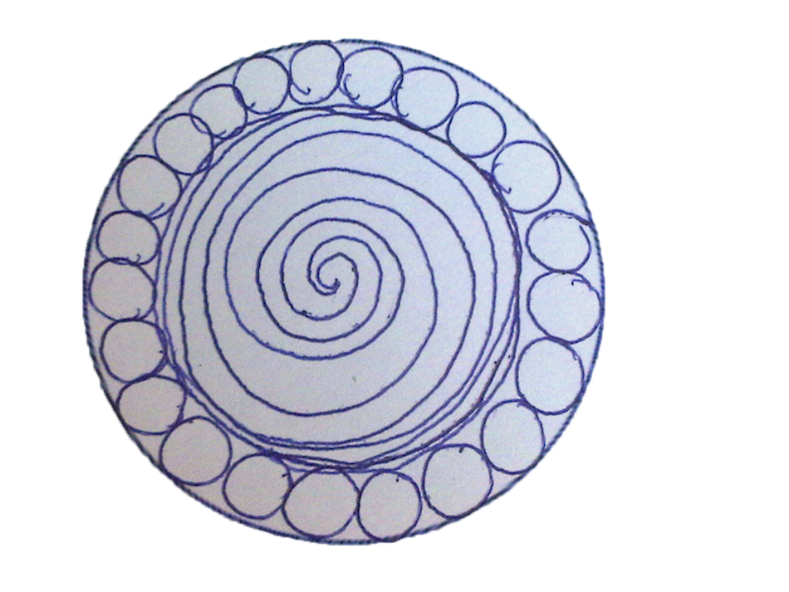
Goal Mometer
Goal: Write Thesis
Sub Goal: Lit. Review
Task: Read Paper 1
Task: Read Paper 2
Sub Goal: Make Outline
Sub Goal: Write Thesis
Task: Intro
Sub Task: Write Abstract
Task: Content
Sub Task: Write ¶ 1
Sub Task: Write ¶ 2
Task: Conclusion

Slide 73
Goal Mometer
Goal: Write Thesis
Sub Goal: Lit. Review
Task: Read Paper 1
Task: Read Paper 2
Sub Goal: Make Outline
Sub Goal: Write Thesis
Task: Intro
Sub Task: Write Abstract
Task: Content
Sub Task: Write ¶ 1
Sub Task: Write ¶ 2
Task: Conclusion

Slide 74
Goal Mometer
Goal: Write Thesis
Sub Goal: Lit. Review
Sub Goal: Lit. Review
Sub Goal: Make Outline
Sub Goal: Make Outline
Sub Goal: Write Thesis
Sub Goal: Write Thesis
Task: Intro
Task: Intro
Sub Task: Write Abstract
Sub Task: Write Abstract
Task: Content
Task: Content
Sub Task: Write ¶ 1
Sub Task: Write ¶ 1
Sub Task: Write ¶ 2
Sub Task: Write ¶ 2
Task: Conclusion
Task: Conclusion

Slide 75
Goal Mometer
Goal: Write Thesis
Sub Goal: Lit. Review
Sub Goal: Make Outline
Sub Goal: Write Thesis
Task: Intro
Sub Task: Write Abstract
Task: Content
Sub Task: Write ¶ 1
Sub Task: Write ¶ 2
Task: Conclusion

Slide 76
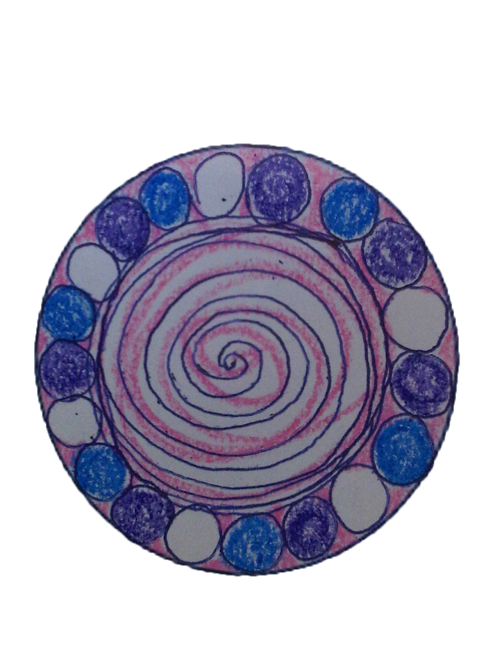
Goal Mometer
Goal: Write Thesis
Sub Goal: Lit. Review
Task: Read Paper 1
Task: Read Paper 2
Sub Goal: Make Outline
Sub Goal: Write Thesis
Task: Intro
Sub Task: Write Abstract
Task: Content
Sub Task: Write ¶ 1
Sub Task: Write ¶ 2
Task: Conclusion

Slide 77
Goal Mometer
Goal: Write Thesis
Sub Goal: Lit. Review
Task: Read Paper 1
Task: Read Paper 2
Sub Goal: Make Outline
Sub Goal: Write Thesis
Task: Intro
Sub Task: Write Abstract
Task: Content
Sub Task: Write ¶ 1
Sub Task: Write ¶ 2
Task: Conclusion

Slide 78
Goal Mometer
Goal: Write Thesis
Sub Goal: Lit. Review
Sub Goal: Make Outline
Sub Goal: Write Thesis
Task: Intro
Sub Task: Write Abstract
Task: Content
Sub Task: Write ¶ 1
Sub Task: Write ¶ 2
Task: Conclusion

Slide 79
Goal Mometer
Goal: Write Thesis
Sub Goal: Lit. Review
Sub Goal: Make Outline
Sub Goal: Write Thesis
Task: Intro
Sub Task: Write Abstract
Task: Content
Sub Task: Write ¶ 1
Sub Task: Write ¶ 2
Task: Conclusion

Slide 80
Goal Mometer
Goal: Write Thesis
Sub Goal: Lit. Review
Task: Read Paper 1

Slide 81
Goal Mometer
Goal: Write Thesis
Sub Goal: Lit. Review
Task: Read Paper 1

Slide 82
Goal Mometer
Goal: Write Thesis
Sub Goal: Lit. Review
Task: Read Paper 1
Task: Read Paper 2

Slide 83
Goal Mometer
Goal: Write Thesis
Sub Goal: Lit. Review
Task: Read Paper 1
Task: Read Paper 2

Slide 84
Goal Mometer
Goal: Write Thesis
Sub Goal: Lit. Review
Task: Read Paper 1
Task: Read Paper 2

Slide 85
Goal Mometer
Goal: Write Thesis
Sub Goal: Lit. Review
Task: Read Paper 1
Task: Read Paper 2

Slide 86
Goal Mometer
Goal: Write Thesis
Sub Goal: Lit. Review

Slide 87
Goal Mometer
Goal: Write Thesis
Sub Goal: Lit. Review

Slide 88
Goal Mometer
Goal: Write Thesis
Sub Goal: Lit. Review
Sub Goal: Make Outline

Slide 89
Goal Mometer
Goal: Write Thesis
Sub Goal: Lit. Review
Sub Goal: Make Outline

Slide 90
Goal Mometer
Goal: Write Thesis
Sub Goal: Lit. Review
Task: Read Paper 1
Task: Read Paper 2
Sub Goal: Make Outline

Slide 91
Goal Mometer
Goal: Write Thesis
Sub Goal: Lit. Review
Task: Read Paper 1
Task: Read Paper 2
Sub Goal: Make Outline

Slide 92
Goal Mometer
Goal: Write Thesis
Sub Goal: Lit. Review
Sub Goal: Make Outline

Slide 93
Goal Mometer
Goal: Write Thesis
Sub Goal: Lit. Review
Sub Goal: Make Outline

Slide 94
Goal Mometer
Goal: Write Thesis
Sub Goal: Lit. Review
Task: Read Paper 1
Task: Read Paper 2
Sub Goal: Make Outline

Slide 95
Goal Mometer
Goal: Write Thesis
Sub Goal: Lit. Review
Task: Read Paper 1
Task: Read Paper 2
Sub Goal: Make Outline

Slide 96
Goal Mometer
Goal: Write Thesis
Sub Goal: Lit. Review
Task: Read Paper 1
Task: Read Paper 2
Sub Goal: Make Outline
Sub Goal: Write Thesis

Slide 97
Goal Mometer
Goal: Write Thesis
Sub Goal: Lit. Review
Task: Read Paper 1
Task: Read Paper 2
Sub Goal: Make Outline
Sub Goal: Write Thesis

Slide 98
Goal Mometer
Goal: Write Thesis
Sub Goal: Lit. Review
Sub Goal: Make Outline
Sub Goal: Write Thesis

Slide 99
Goal Mometer
Goal: Write Thesis
Sub Goal: Lit. Review
Sub Goal: Make Outline
Sub Goal: Write Thesis

Slide 100
Goal Mometer
Goal: Write Thesis
Sub Goal: Lit. Review
Sub Goal: Make Outline
Sub Goal: Write Thesis
Task: Intro

Slide 101
Goal Mometer
Goal: Write Thesis
Sub Goal: Lit. Review
Sub Goal: Make Outline
Sub Goal: Write Thesis
Task: Intro

Slide 102
Goal Mometer
Goal: Write Thesis
Sub Goal: Lit. Review
Task: Read Paper 1
Task: Read Paper 2
Sub Goal: Make Outline
Sub Goal: Write Thesis
Task: Intro

Slide 103
Goal Mometer
Goal: Write Thesis
Sub Goal: Lit. Review
Task: Read Paper 1
Task: Read Paper 2
Sub Goal: Make Outline
Sub Goal: Write Thesis
Task: Intro

Slide 104
Goal Mometer
Goal: Write Thesis
Sub Goal: Lit. Review
Sub Goal: Make Outline
Sub Goal: Write Thesis
Task: Intro
Sub Task: Write Abstract

Slide 105
Goal Mometer
Goal: Write Thesis
Sub Goal: Lit. Review
Sub Goal: Make Outline
Sub Goal: Write Thesis
Task: Intro
Sub Task: Write Abstract

Slide 106
Goal Mometer
Goal: Write Thesis
Sub Goal: Lit. Review
Task: Read Paper 1
Task: Read Paper 2
Sub Goal: Make Outline
Sub Goal: Write Thesis
Task: Intro
Sub Task: Write Abstract

Slide 107
Goal Mometer
Goal: Write Thesis
Sub Goal: Lit. Review
Task: Read Paper 1
Task: Read Paper 2
Sub Goal: Make Outline
Sub Goal: Write Thesis
Task: Intro
Sub Task: Write Abstract

Slide 108
Goal Mometer
Goal: Write Thesis
Sub Goal: Lit. Review
Sub Goal: Make Outline
Sub Goal: Write Thesis
Task: Intro
Sub Task: Write Abstract

Slide 109
Goal Mometer
Goal: Write Thesis
Sub Goal: Lit. Review
Sub Goal: Make Outline
Sub Goal: Write Thesis
Task: Intro
Sub Task: Write Abstract

Slide 110
Goal Mometer
Goal: Write Thesis
Sub Goal: Lit. Review
Sub Goal: Make Outline
Sub Goal: Write Thesis
Task: Intro
Sub Task: Write Abstract
Task: Content

Slide 111
Goal Mometer
Goal: Write Thesis
Sub Goal: Lit. Review
Sub Goal: Make Outline
Sub Goal: Write Thesis
Task: Intro
Sub Task: Write Abstract
Task: Content

Slide 112
Goal Mometer
Goal: Write Thesis
Sub Goal: Lit. Review
Sub Goal: Make Outline
Sub Goal: Write Thesis
Task: Intro
Sub Task: Write Abstract
Task: Content
Sub Task: Write ¶ 1

Slide 113
Goal Mometer
Goal: Write Thesis
Sub Goal: Lit. Review
Sub Goal: Make Outline
Sub Goal: Write Thesis
Task: Intro
Sub Task: Write Abstract
Task: Content
Sub Task: Write ¶ 1

Slide 114
Goal Mometer
Goal: Write Thesis
Sub Goal: Lit. Review
Task: Read Paper 1
Task: Read Paper 2
Sub Goal: Make Outline
Sub Goal: Write Thesis
Task: Intro
Sub Task: Write Abstract

Slide 115
Goal Mometer
Goal: Write Thesis
Sub Goal: Lit. Review
Task: Read Paper 1
Task: Read Paper 2
Sub Goal: Make Outline
Sub Goal: Write Thesis
Task: Intro
Sub Task: Write Abstract

Slide 116
Goal Mometer
Goal: Write Thesis
Sub Goal: Lit. Review
Task: Read Paper 1
Task: Read Paper 2
Sub Goal: Make Outline
Sub Goal: Write Thesis
Task: Intro
Sub Task: Write Abstract
Task: Content

Slide 117
Goal Mometer
Goal: Write Thesis
Sub Goal: Lit. Review
Task: Read Paper 1
Task: Read Paper 2
Sub Goal: Make Outline
Sub Goal: Write Thesis
Task: Intro
Sub Task: Write Abstract
Task: Content

Slide 118
Goal Mometer
Goal: Write Thesis
Sub Goal: Lit. Review
Task: Read Paper 1
Task: Read Paper 2
Sub Goal: Make Outline
Sub Goal: Write Thesis
Task: Intro
Sub Task: Write Abstract
Task: Content
Sub Task: Write ¶ 1

Slide 119
Goal Mometer
Goal: Write Thesis
Sub Goal: Lit. Review
Task: Read Paper 1
Task: Read Paper 2
Sub Goal: Make Outline
Sub Goal: Write Thesis
Task: Intro
Sub Task: Write Abstract
Task: Content
Sub Task: Write ¶ 1

Slide 120
Goal Mometer
Goal: Write Thesis
Sub Goal: Lit. Review
Sub Goal: Make Outline
Sub Goal: Write Thesis
Task: Intro
Sub Task: Write Abstract
Task: Content
Sub Task: Write ¶ 1

Slide 121
Goal Mometer
Goal: Write Thesis
Sub Goal: Lit. Review
Sub Goal: Make Outline
Sub Goal: Write Thesis
Task: Intro
Sub Task: Write Abstract
Task: Content
Sub Task: Write ¶ 1

Slide 122
Goal Mometer
Goal: Write Thesis
Sub Goal: Lit. Review
Sub Goal: Make Outline
Sub Goal: Write Thesis
Task: Intro
Sub Task: Write Abstract
Task: Content
Sub Task: Write ¶ 1
Sub Task: Write ¶ 2

Slide 123
Goal Mometer
Goal: Write Thesis
Sub Goal: Lit. Review
Sub Goal: Make Outline
Sub Goal: Write Thesis
Task: Intro
Sub Task: Write Abstract
Task: Content
Sub Task: Write ¶ 1
Sub Task: Write ¶ 2

Slide 124
Goal Mometer
Goal: Write Thesis
Sub Goal: Lit. Review
Task: Read Paper 1
Task: Read Paper 2
Sub Goal: Make Outline
Sub Goal: Write Thesis
Task: Intro
Sub Task: Write Abstract
Task: Content
Sub Task: Write ¶ 1

Slide 125
Goal Mometer
Goal: Write Thesis
Sub Goal: Lit. Review
Task: Read Paper 1
Task: Read Paper 2
Sub Goal: Make Outline
Sub Goal: Write Thesis
Task: Intro
Sub Task: Write Abstract
Task: Content
Sub Task: Write ¶ 1

Slide 126
Goal Mometer
Goal: Write Thesis
Sub Goal: Lit. Review
Task: Read Paper 1
Task: Read Paper 2
Sub Goal: Make Outline
Sub Goal: Write Thesis
Task: Intro
Sub Task: Write Abstract
Task: Content
Sub Task: Write ¶ 1
Sub Task: Write ¶ 2

Slide 127
Goal Mometer
Goal: Write Thesis
Sub Goal: Lit. Review
Task: Read Paper 1
Task: Read Paper 2
Sub Goal: Make Outline
Sub Goal: Write Thesis
Task: Intro
Sub Task: Write Abstract
Task: Content
Sub Task: Write ¶ 1
Sub Task: Write ¶ 2

Slide 128
Goal Mometer
Goal: Write Thesis
Sub Goal: Lit. Review
Sub Goal: Make Outline
Sub Goal: Write Thesis
Task: Intro
Sub Task: Write Abstract
Task: Content
Sub Task: Write ¶ 1
Sub Task: Write ¶ 2

Slide 129
Goal Mometer
Goal: Write Thesis
Sub Goal: Lit. Review
Sub Goal: Make Outline
Sub Goal: Write Thesis
Task: Intro
Sub Task: Write Abstract
Task: Content
Sub Task: Write ¶ 1
Sub Task: Write ¶ 2

Slide 130
Goal Mometer
Goal: Write Thesis
Sub Goal: Lit. Review
Sub Goal: Make Outline
Sub Goal: Write Thesis
Task: Intro
Sub Task: Write Abstract
Task: Content
Sub Task: Write ¶ 1
Sub Task: Write ¶ 2
Task: Conclusion

Slide 131
Goal Mometer
Goal: Write Thesis
Sub Goal: Lit. Review
Sub Goal: Make Outline
Sub Goal: Write Thesis
Task: Intro
Sub Task: Write Abstract
Task: Content
Sub Task: Write ¶ 1
Sub Task: Write ¶ 2
Task: Conclusion

Slide 132
Goal Mometer
Goal: Write Thesis
Sub Goal: Lit. Review
Task: Read Paper 1
Task: Read Paper 2
Sub Goal: Make Outline
Sub Goal: Write Thesis
Task: Intro
Sub Task: Write Abstract
Task: Content
Sub Task: Write ¶ 1
Sub Task: Write ¶ 2

Slide 133
Goal Mometer
Goal: Write Thesis
Sub Goal: Lit. Review
Task: Read Paper 1
Task: Read Paper 2
Sub Goal: Make Outline
Sub Goal: Write Thesis
Task: Intro
Sub Task: Write Abstract
Task: Content
Sub Task: Write ¶ 1
Sub Task: Write ¶ 2

Slide 134
Goal Mometer
Goal: Write Thesis
Sub Goal: Lit. Review
Task: Read Paper 1
Task: Read Paper 2
Sub Goal: Make Outline
Sub Goal: Write Thesis
Task: Intro
Sub Task: Write Abstract
Task: Content
Sub Task: Write ¶ 1
Sub Task: Write ¶ 2
Task: Conclusion

Slide 135
Goal Mometer
Goal: Write Thesis
Sub Goal: Lit. Review
Task: Read Paper 1
Task: Read Paper 2
Sub Goal: Make Outline
Sub Goal: Write Thesis
Task: Intro
Sub Task: Write Abstract
Task: Content
Sub Task: Write ¶ 1
Sub Task: Write ¶ 2
Task: Conclusion

Slide 136
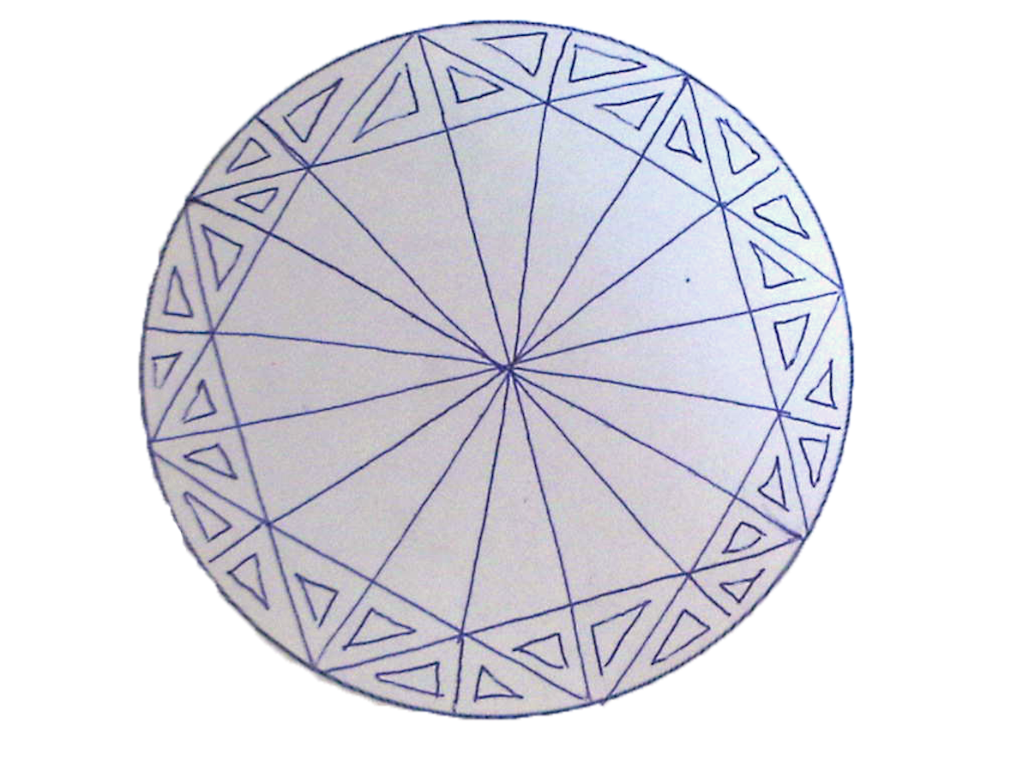
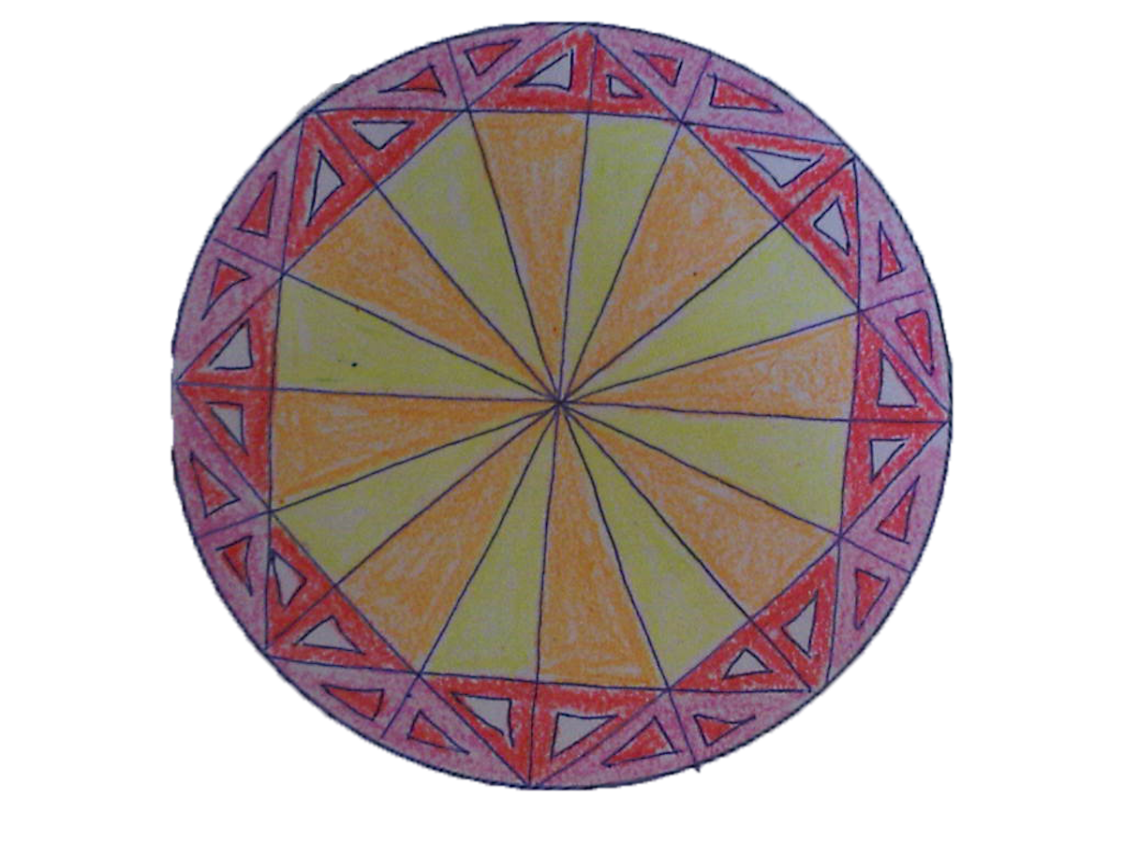
Goal Mometer
Goal: Write Thesis
Sub Goal: Lit. Review
Sub Goal: Make Outline
Sub Goal: Write Thesis
Task: Intro
Sub Task: Write Abstract
Task: Content
Sub Task: Write ¶ 1
Sub Task: Write ¶ 2
Task: Conclusion
End Prototype

Slide 137
Goal Mometer
Goal: Write Thesis
Sub Goal: Lit. Review
Sub Goal: Make Outline
Sub Goal: Write Thesis
Task: Intro
Sub Task: Write Abstract
Task: Content
Sub Task: Write ¶ 1
Sub Task: Write ¶ 2
Task: Conclusion
End Prototype

Slide 138
Goal Mometer
Goal: Write Thesis
Sub Goal: Lit. Review
Sub Goal: Make Outline
Sub Goal: Write Thesis
Task: Intro
Task: Content
Sub Task: Write ¶ 1
Sub Task: Write ¶ 2
Task: Conclusion
End Prototype

Slide 139
Goal Mometer
Goal: Write Thesis
Sub Goal: Lit. Review
Sub Goal: Make Outline
Sub Goal: Write Thesis
Task: Intro
Task: Content
Sub Task: Write ¶ 1
Sub Task: Write ¶ 2
Task: Conclusion
End Prototype

Slide 140
Goal Mometer
Goal: Write Thesis
Sub Goal: Lit. Review
Sub Goal: Make Outline
Sub Goal: Write Thesis
Task: Intro
Sub Task: Write Abstract
Task: Content
Task: Conclusion
End Prototype

Slide 141
Goal Mometer
Goal: Write Thesis
Sub Goal: Lit. Review
Sub Goal: Make Outline
Sub Goal: Write Thesis
Task: Intro
Sub Task: Write Abstract
Task: Content
Task: Conclusion
End Prototype

Slide 142
Goal Mometer
Goal: Write Thesis
Sub Goal: Lit. Review
Sub Goal: Make Outline
Sub Goal: Write Thesis
Task: Intro
Task: Content
Task: Conclusion
End Prototype

Slide 143
Goal Mometer
Goal: Write Thesis
Sub Goal: Lit. Review
Sub Goal: Make Outline
Sub Goal: Write Thesis
Task: Intro
Task: Content
Task: Conclusion
End Prototype

Slide 144
Goal Mometer
Goal: Write Thesis
Sub Goal: Lit. Review
Task: Read Paper 1
Task: Read Paper 2
Sub Goal: Make Outline
Sub Goal: Write Thesis
Task: Intro
Sub Task: Write Abstract
Task: Content
Sub Task: Write ¶ 1
Sub Task: Write ¶ 2
Task: Conclusion
End Prototype

Slide 145
Goal Mometer
Goal: Write Thesis
Sub Goal: Lit. Review
Task: Read Paper 1
Task: Read Paper 2
Sub Goal: Make Outline
Sub Goal: Write Thesis
Task: Intro
Sub Task: Write Abstract
Task: Content
Sub Task: Write ¶ 1
Sub Task: Write ¶ 2
Task: Conclusion
End Prototype

Slide 146
Goal Mometer
Goal: Write Thesis
Sub Goal: Lit. Review
Task: Read Paper 1
Task: Read Paper 2
Sub Goal: Make Outline
Sub Goal: Write Thesis
Task: Intro
Task: Content
Sub Task: Write ¶ 1
Sub Task: Write ¶ 2
Task: Conclusion
End Prototype

Slide 147
Goal Mometer
Goal: Write Thesis
Sub Goal: Lit. Review
Task: Read Paper 1
Task: Read Paper 2
Sub Goal: Make Outline
Sub Goal: Write Thesis
Task: Intro
Task: Content
Sub Task: Write ¶ 1
Sub Task: Write ¶ 2
Task: Conclusion
End Prototype

Slide 148
Goal Mometer
Goal: Write Thesis
Sub Goal: Lit. Review
Task: Read Paper 1
Task: Read Paper 2
Sub Goal: Make Outline
Sub Goal: Write Thesis
Task: Intro
Sub Task: Write Abstract
Task: Content
Task: Conclusion
End Prototype

Slide 149
Goal Mometer
Goal: Write Thesis
Sub Goal: Lit. Review
Task: Read Paper 1
Task: Read Paper 2
Sub Goal: Make Outline
Sub Goal: Write Thesis
Task: Intro
Sub Task: Write Abstract
Task: Content
Task: Conclusion
End Prototype

Slide 150
Goal Mometer
Goal: Write Thesis
Sub Goal: Lit. Review
Task: Read Paper 1
Task: Read Paper 2
Sub Goal: Make Outline
Sub Goal: Write Thesis
Task: Intro
Task: Content
Task: Conclusion
End Prototype

Slide 151
Goal Mometer
Goal: Write Thesis
Sub Goal: Lit. Review
Task: Read Paper 1
Task: Read Paper 2
Sub Goal: Make Outline
Sub Goal: Write Thesis
Task: Intro
Task: Content
Task: Conclusion
End Prototype

Slide 152
Goal Mometer
Goal: Write Thesis
Sub Goal: Lit. Review
Task: Read Paper 1
Task: Read Paper 2
Sub Goal: Make Outline
Sub Goal: Write Thesis
End Prototype

Slide 153
Goal Mometer
Goal: Write Thesis
Sub Goal: Lit. Review
Task: Read Paper 1
Task: Read Paper 2
Sub Goal: Make Outline
Sub Goal: Write Thesis
End Prototype

Slide 154
Goal Mometer
Goal: Write Thesis
Sub Goal: Lit. Review
Sub Goal: Make Outline
Sub Goal: Write Thesis
End Prototype

Slide 155
Goal Mometer
Goal: Write Thesis
Sub Goal: Lit. Review
Sub Goal: Make Outline
Sub Goal: Write Thesis
End Prototype

